Slide 1
Demonstration of
Claim Registration Module screens
1) Accident screen
2) Claims screen
2.1) Own Damage selected
2.2) Property Damage/Bodily Injury selected
3) Service Provider when Insurer selected
4) Notes screen
5) Tasks Screen
6) Attachment Screen
7) Diary Screen
8) Reserve Screen
8.1) OD Reserve Request selected
8.2) PD Reserve Request Claim Selected
8.3) BI Reserve Request Claim Selected
8.4) LOG Request Selected
9) Mandate Screen
10) Payment Screen
11) Transaction History Screen

Slide 2
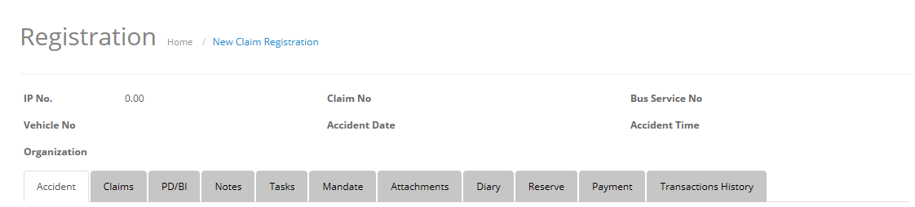
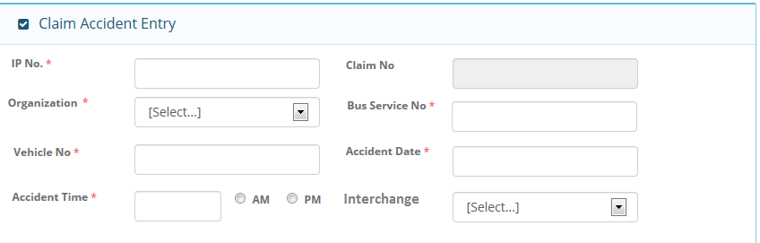
1) Accident Screen
1.1) Accident screen Header
1.2) Accident Screen -> Claim Accident Entry Section

Slide 3
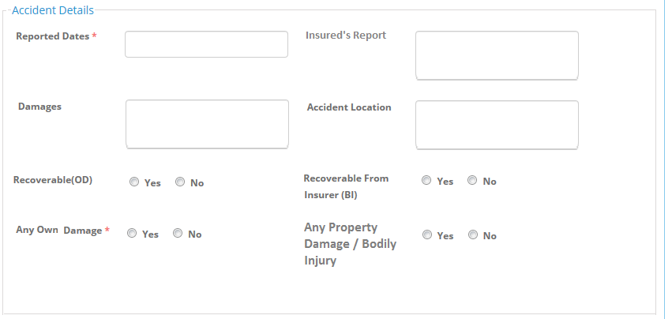
1.3) Accident Screen -> Accident Details section

Slide 4
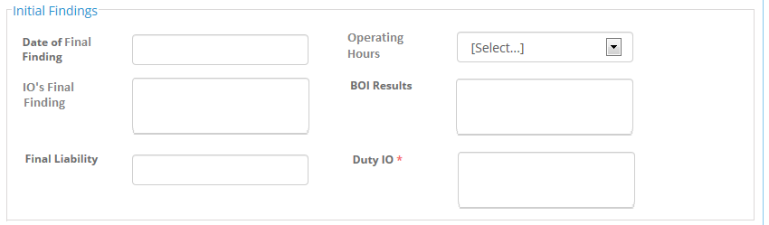
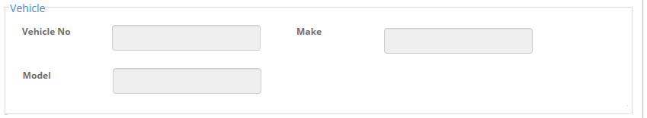
1.4) Accident Screen -> Initial Findings Section
1.5) Accident Screen -> Vehicle Section

Slide 5
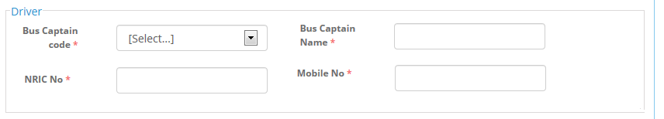
1.6) Accident Screen -> Driver Section
1.7) Accident Screen -> Footer

Slide 6
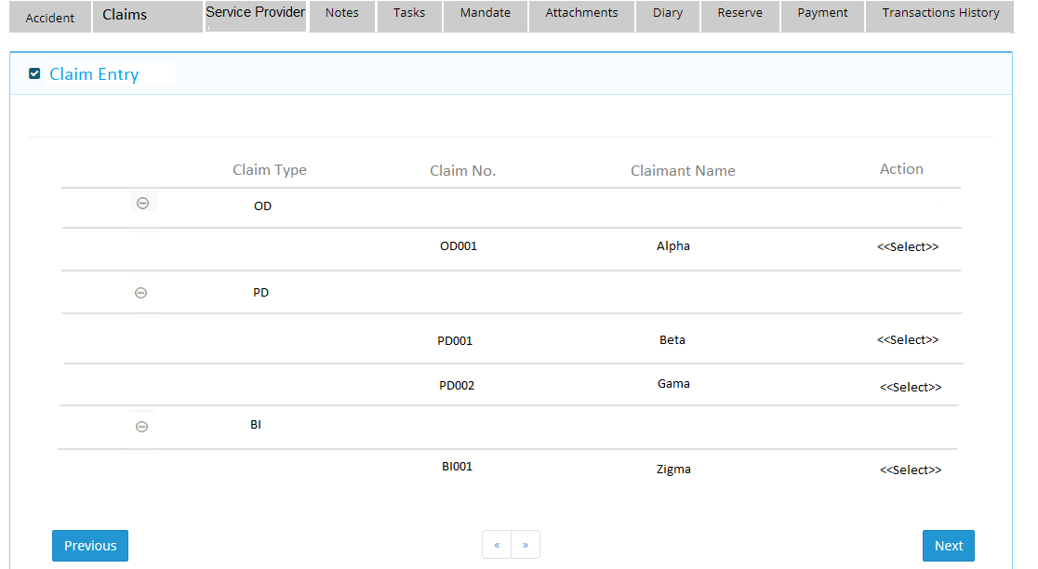
2) Claims Screen
2.1) Claims Screen when Own Damage selected
2.1.a ) Grid of Claims Screen

Slide 7
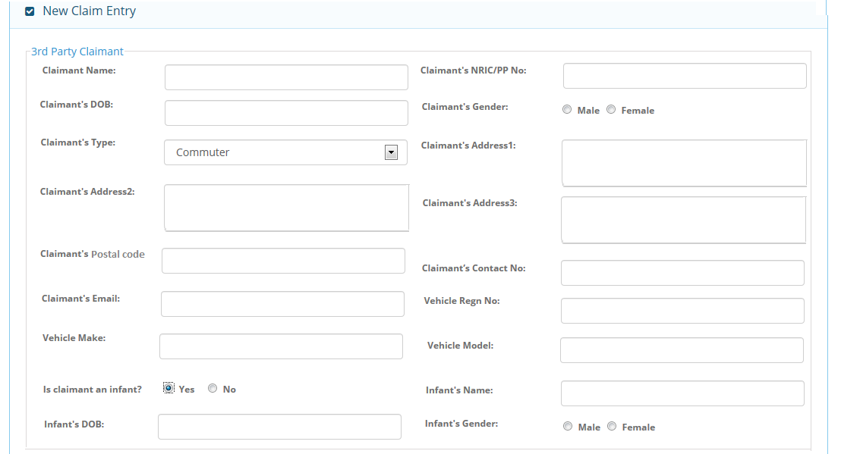
2.1.b) 3rd Party Claimant Section

Slide 8
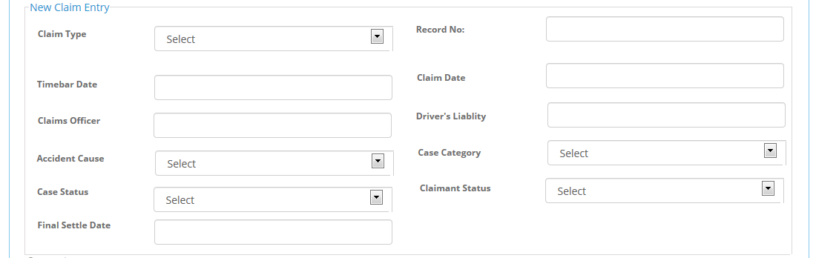
2.1.C) New Claim Entry Section

Slide 9
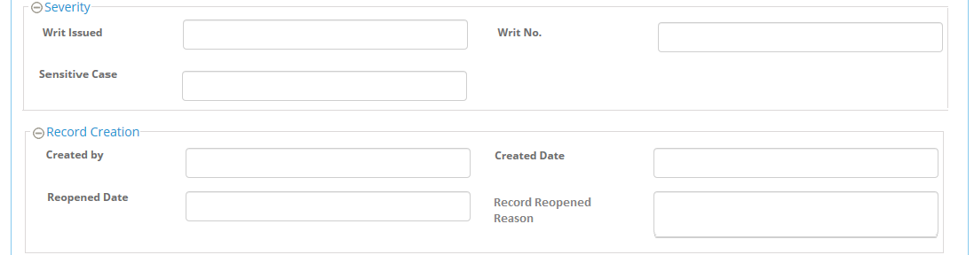
2.1.d) Severity and Record Creation Section

Slide 10
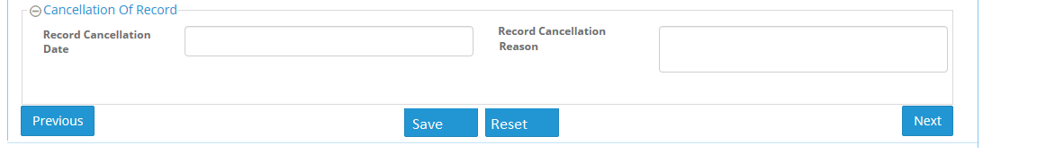
2.1.e) Cancellation of Record Section and Footer

Slide 11
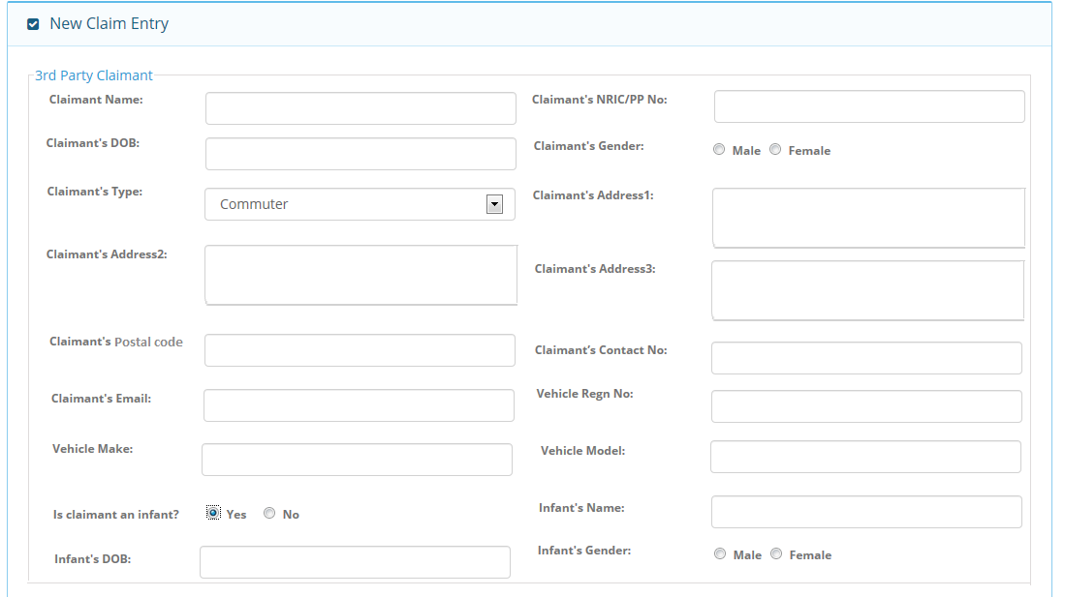
2.2) Claims Screen when Property Damage / Bodily Injury selected
2.2.a) 3rd Party Section

Slide 12
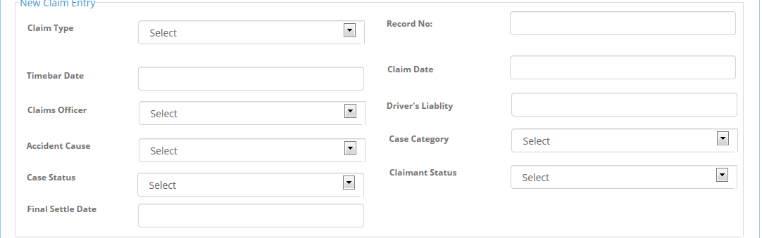
2.2.b) New Claim Entry Section

Slide 13
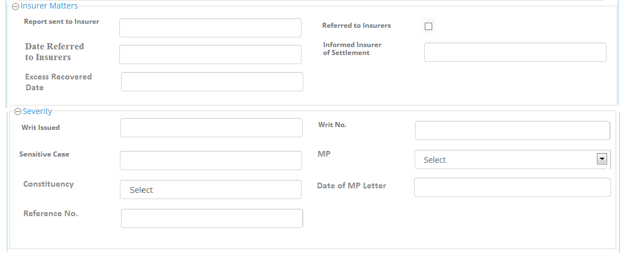
2.2.c) Insurer Matters and Severity Section

Slide 14
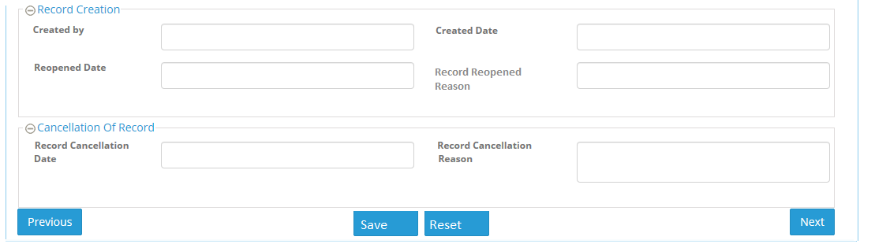
2.2.d) Record Creation and Cancellation of Record Section

Slide 15
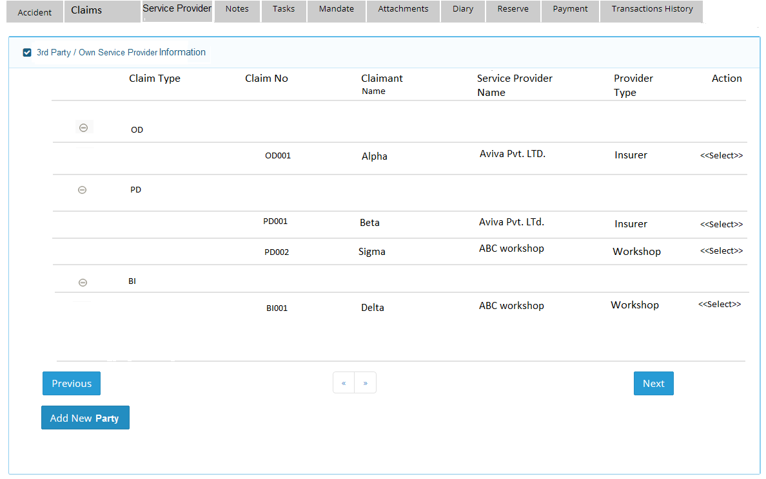
3) Service Provider Screen
3.1) Grid section

Slide 16
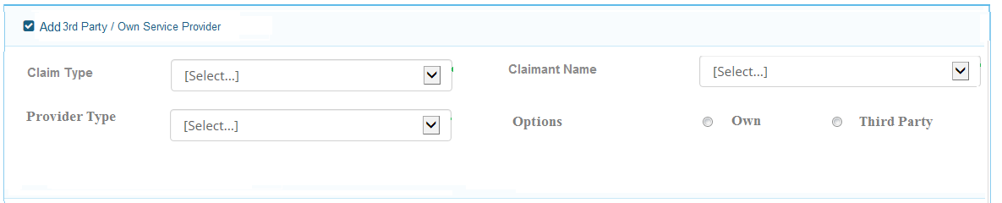
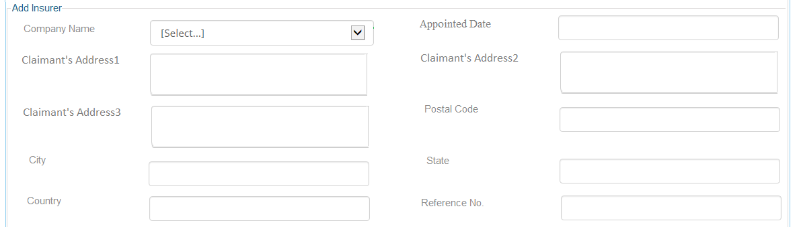
3.2) Add 3rd Party / Own Service Provider section(Input Criteria for Service provider )
3.3) Add Insurer Section (Partial Part)

Slide 17
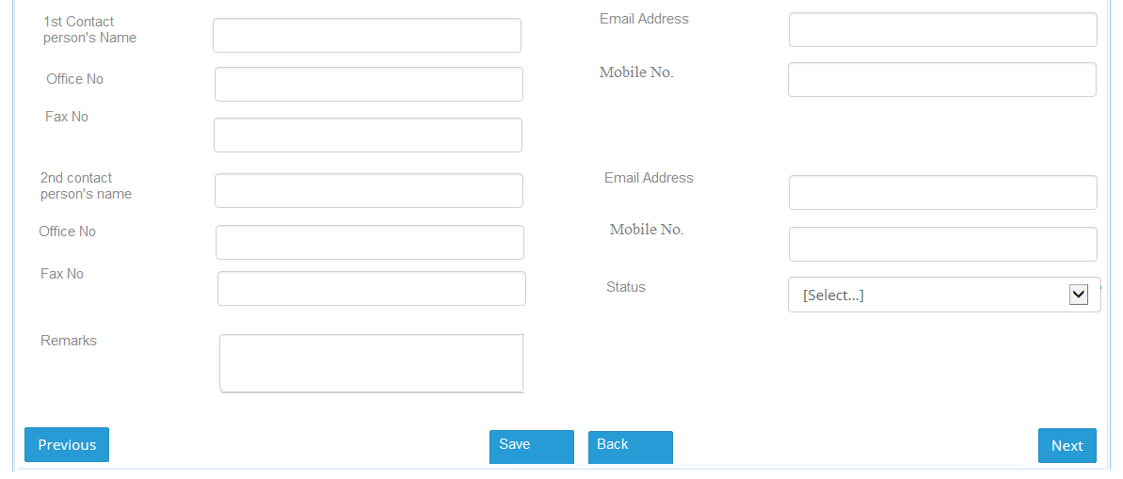
3.3) Add Insurer Section ( Remaining Part)

Slide 18
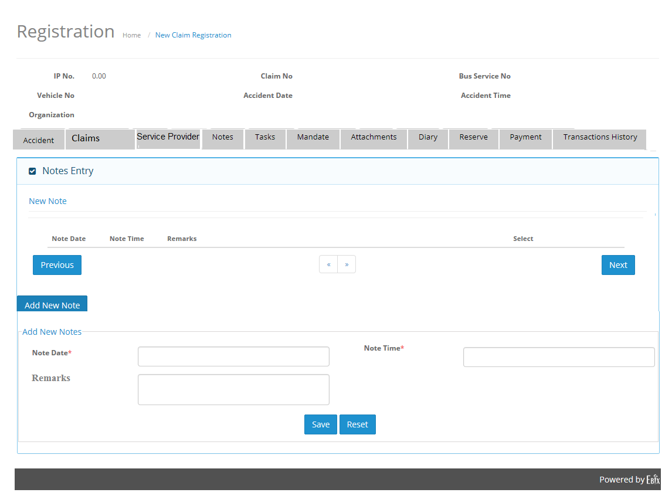
4) Notes Screen
4.1) Grid and Add Section

Slide 19
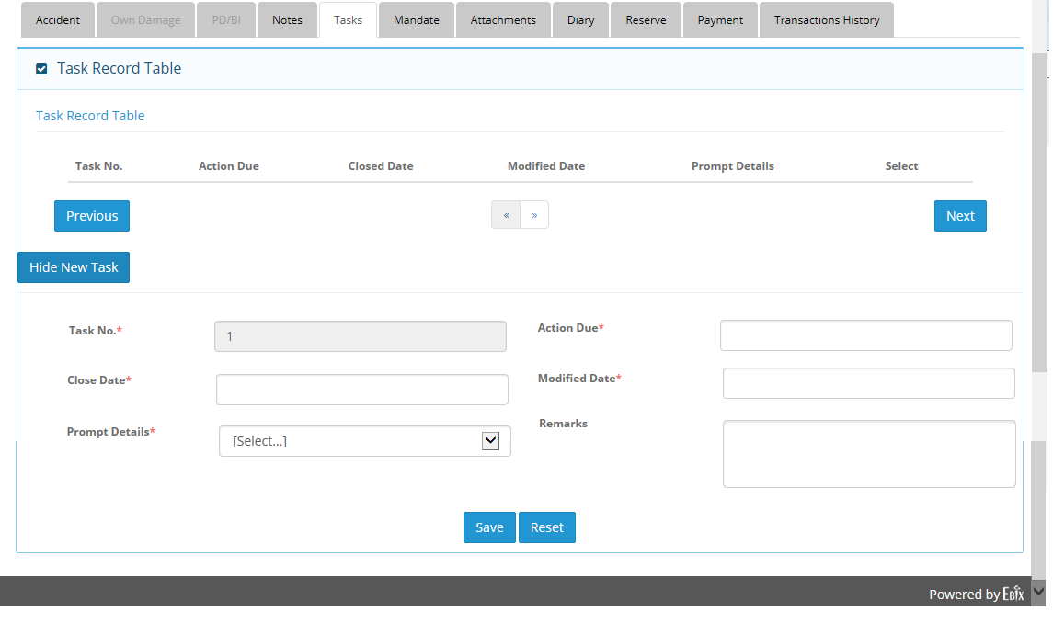
5) Tasks Screen
5.1) Grid and Add Section

Slide 20
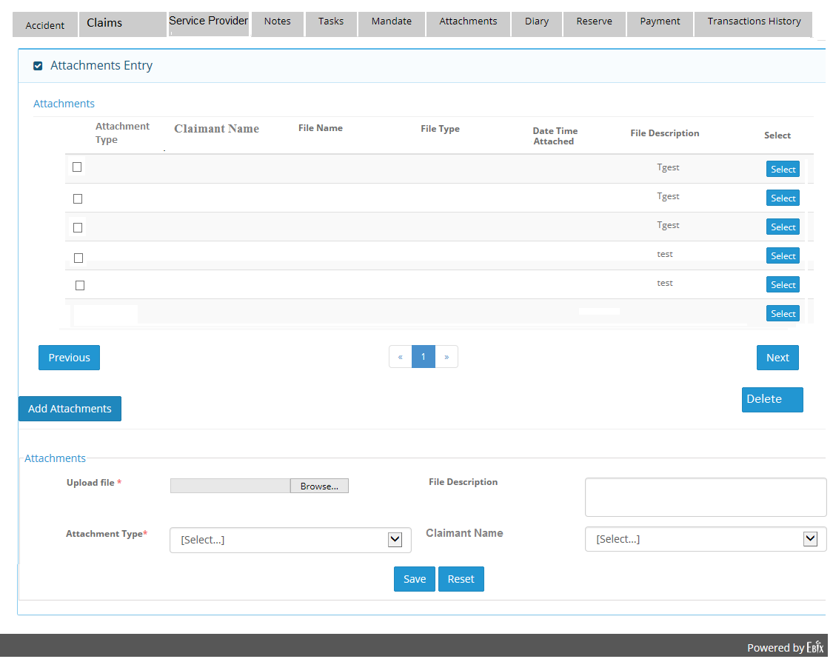
6) Attachment Screen
6.1) Grid and Add Section

Slide 21
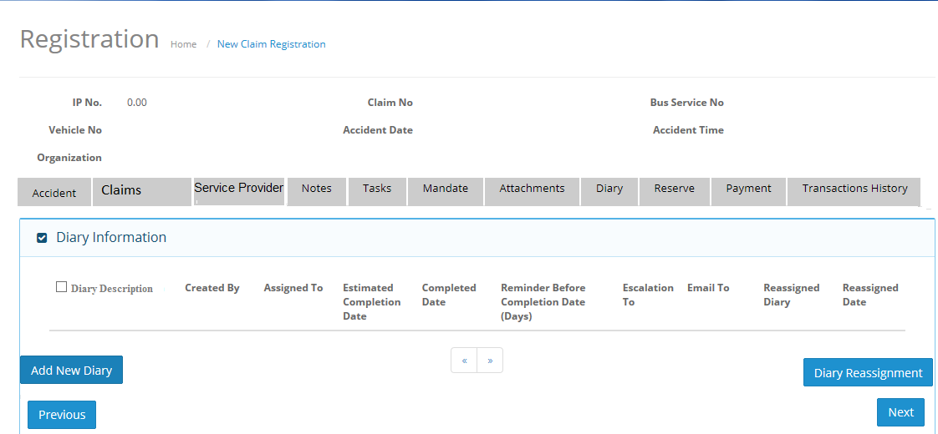
7) Diary Screen
7.1) Header and Grid Section

Slide 22
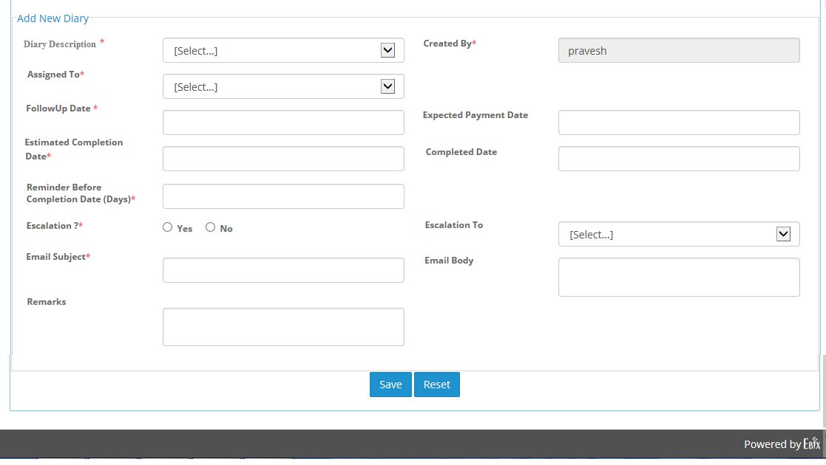
7.2) Add New Diary Screen

Slide 23
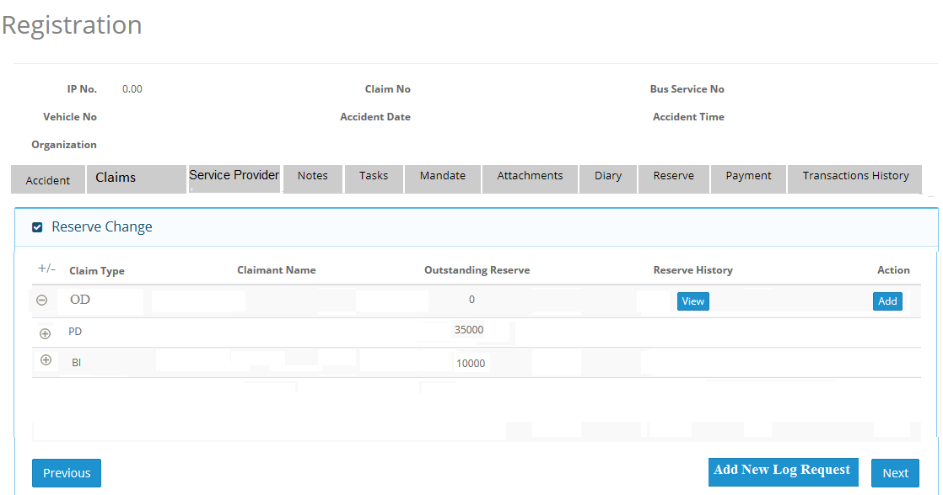
8) Reserve Screen
8.1) Own Damage Reserve Request
8.1.a) Header and Grid Section

Slide 24
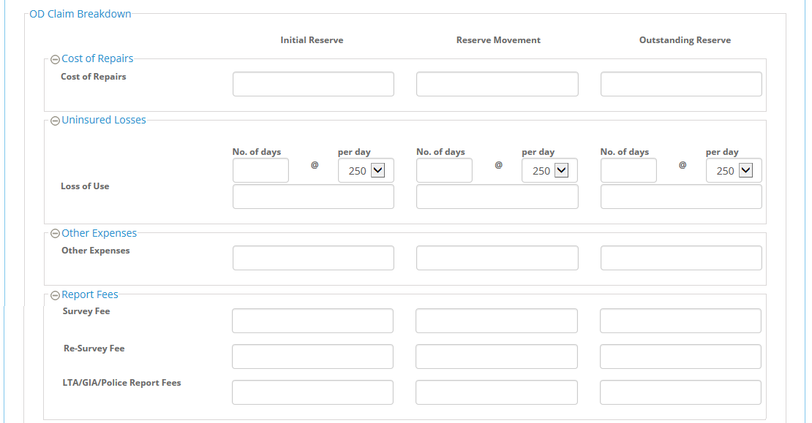
8.1.b) OD Claim Reserve Request sections ( Partial Part )
a) Cost of Repairs,b) Uninsured Losses, c) Other Expenses, d) Report Fees

Slide 25
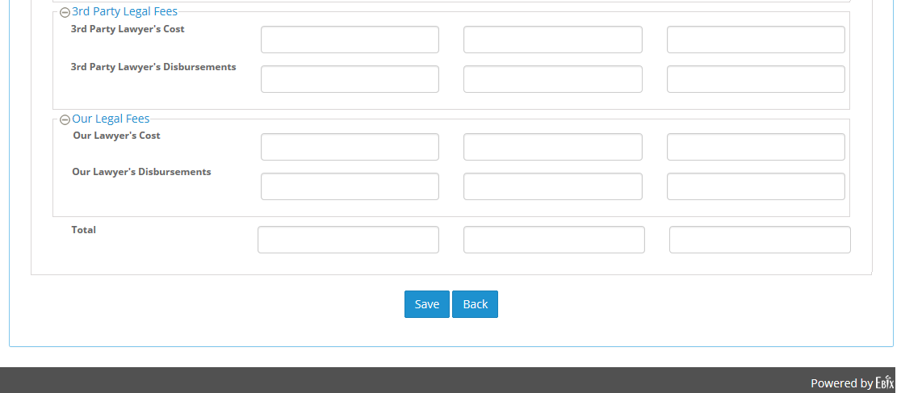
8.1.b) OD Claim Reserve Request sections ( Remaining Part )
e) 3rd Party legal Fees, f) Our Legal Fees

Slide 26
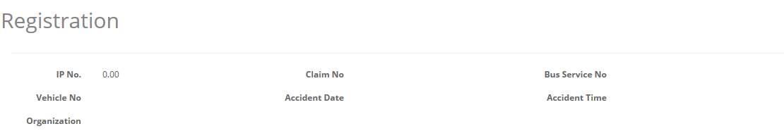
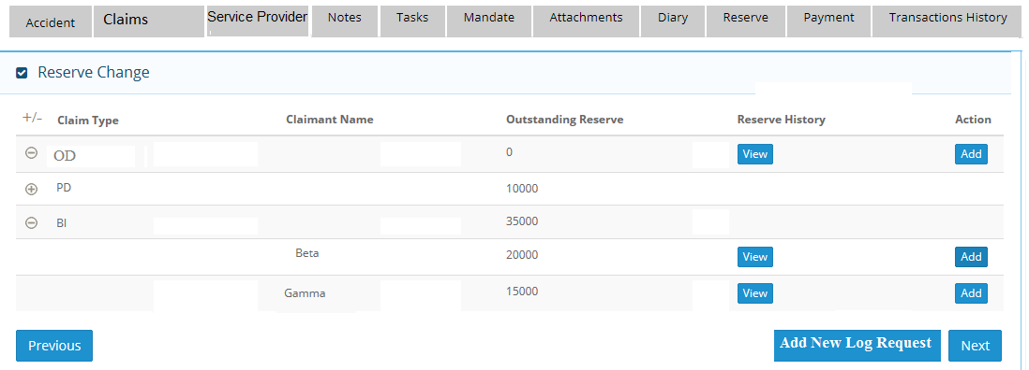
8.2) Bodily Injury(BI) Reserve Request
8.2.a) Header and Grid Section

Slide 27
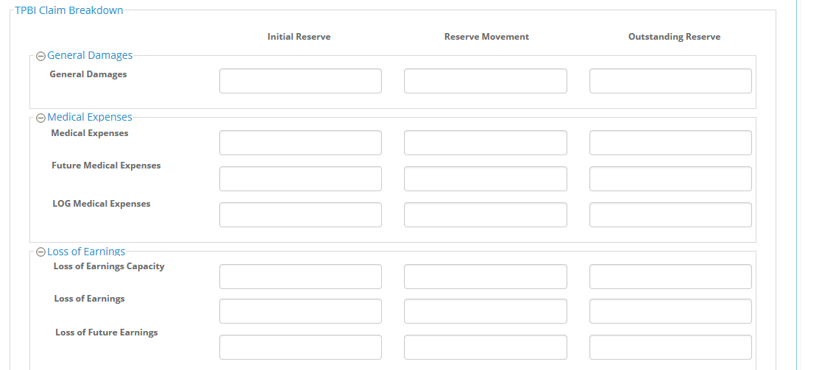
8.2.b) BI Claim Reserve Request sections (Partial Part)
a) General Damages, b) Medical Expenses, c) Loss of Earnings

Slide 28
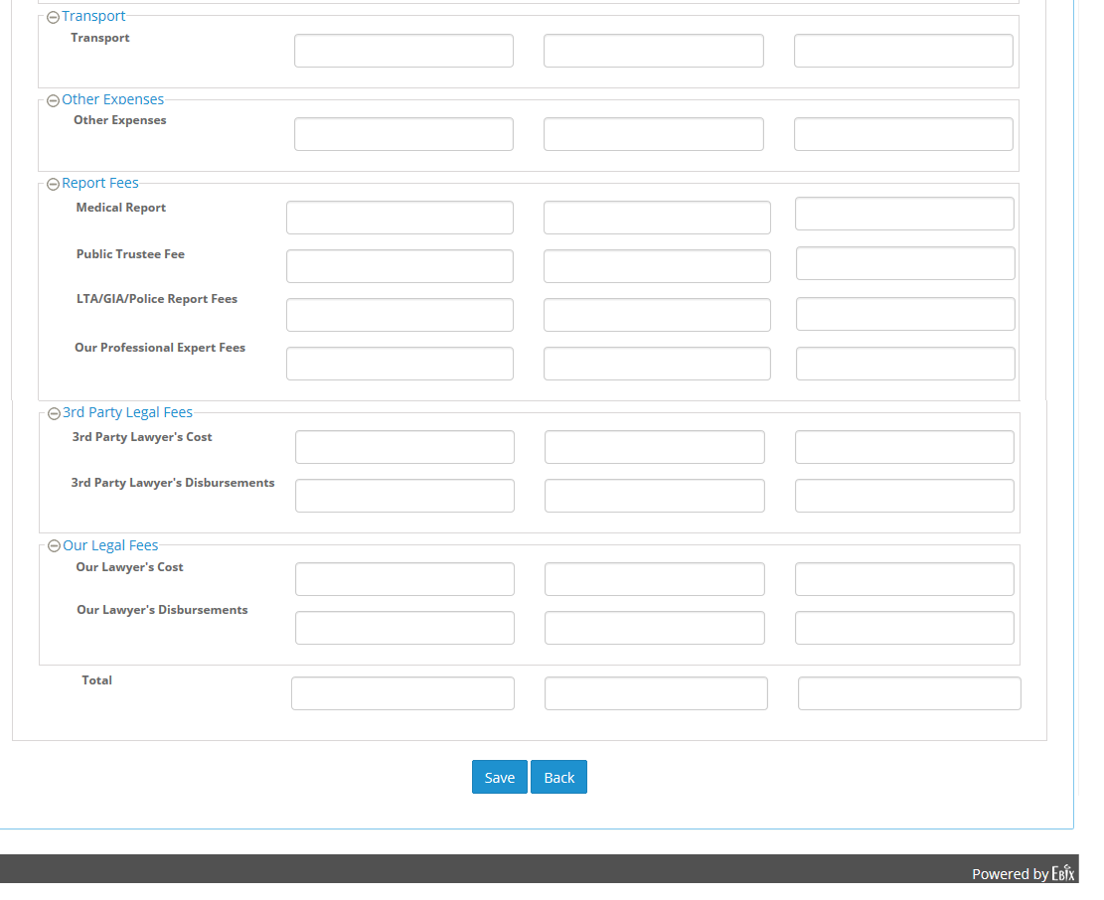
8.2.b) BI Claim Reserve Request sections (Remaining Part)
d) Transport, e) Other Expenses, f) Report Fees, g) 3rd Party Legal Fees, I) Our Legal Fees

Slide 29
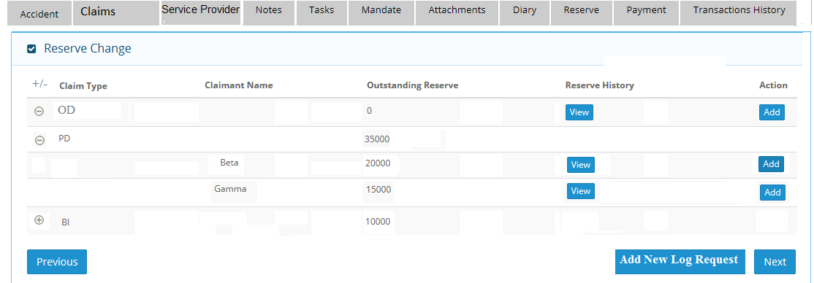
8.3) Property Damage(PD) Reserve Request
8.3.a) Header and Grid Section

Slide 30
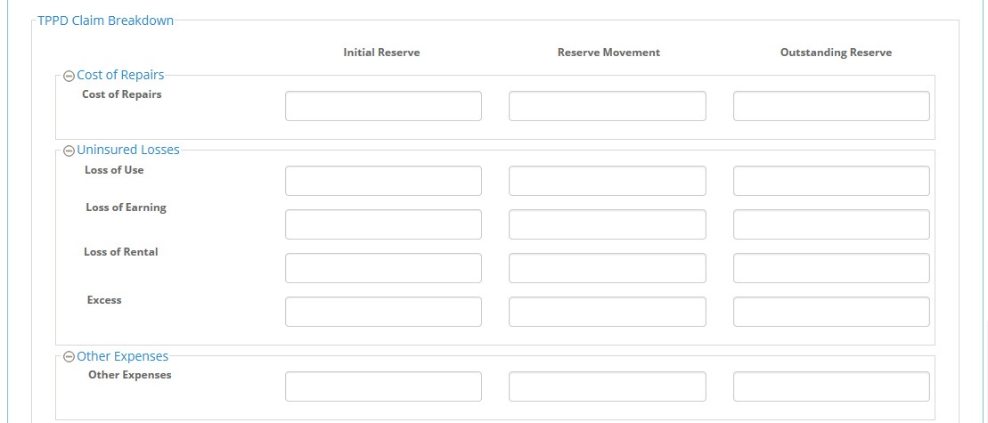
8.3.b) PD Claim Reserve Request sections (Partial Part)
a) Cost of Repairs, b) Uninsured Losses, c) Other Expenses

Slide 31
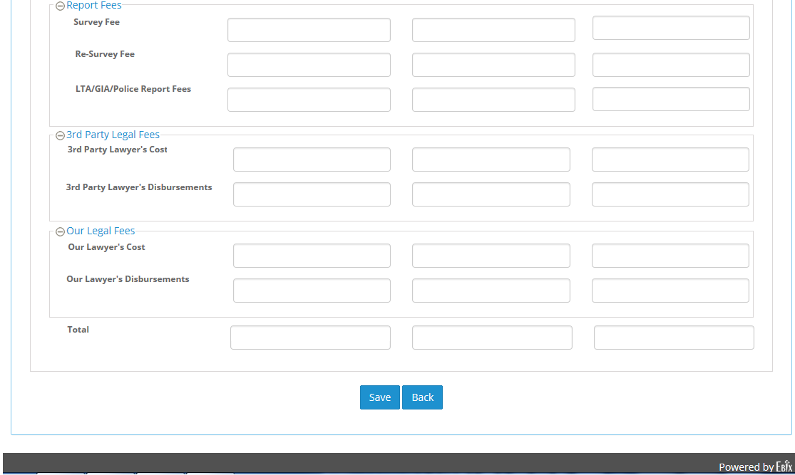
8.3.b) PD Claim Reserve Request sections (Remaining Part)
d) Report Fees, e) 3rd Party Legal Fees, f) Our Legal Fees

Slide 32
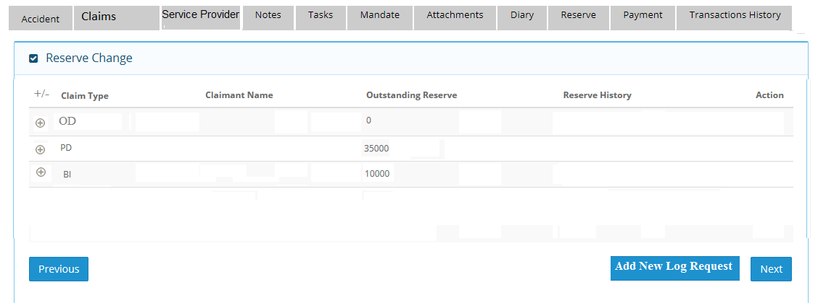
8.4) LOG Request
8.4.a) Header and Grid Section

Slide 33
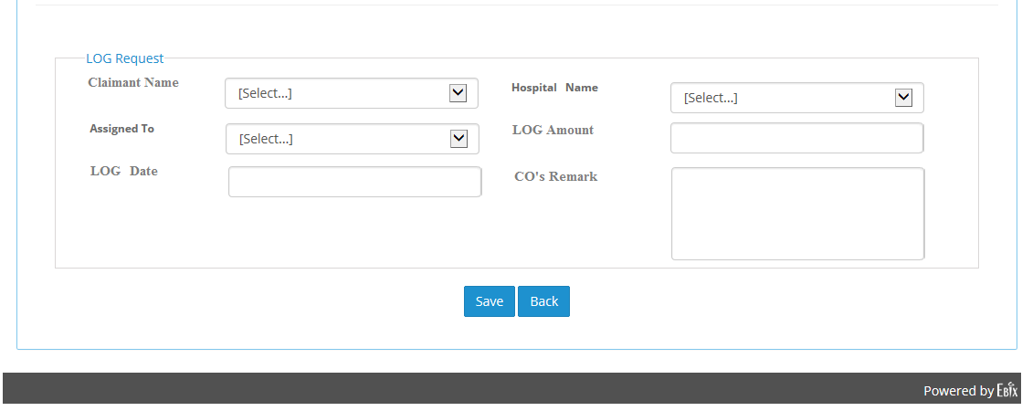
8.4.b) Add LOG Request section

Slide 34
9. Mandate Mockup Screens
1) TPPD Mandate Approval
2) TPBI Mandate Approval
3) OD Mandate Approval

Slide 35
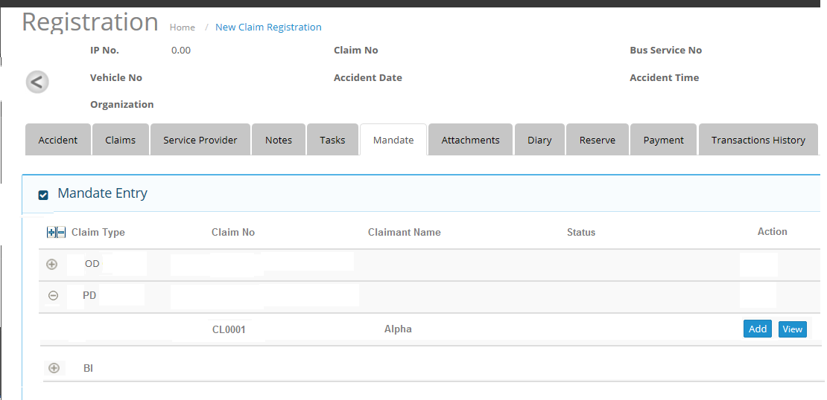
9.1) TPPD Mandate Approval
9.1.1) Header and Grid Section

Slide 36
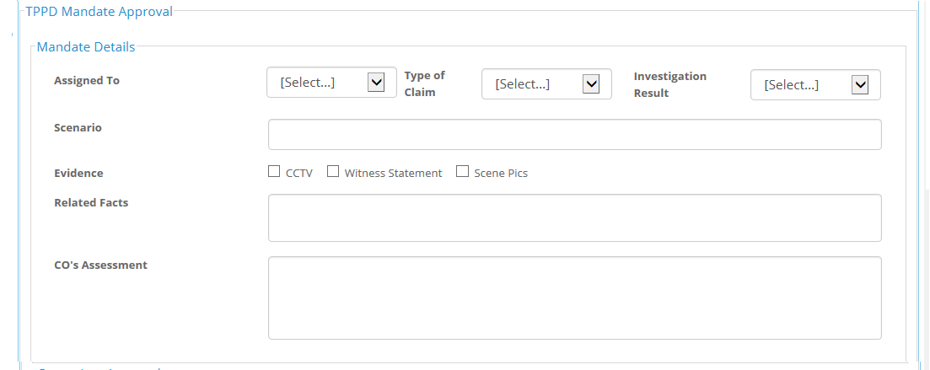
9.1.2) Mandate Details section under TPPD Mandate Approval Frame

Slide 37
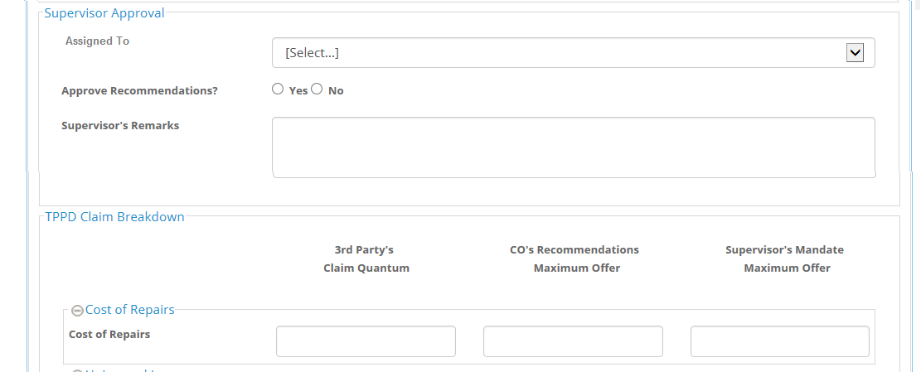
9.1.3) Supervisor Approval section and Cost of Repairs section

Slide 38
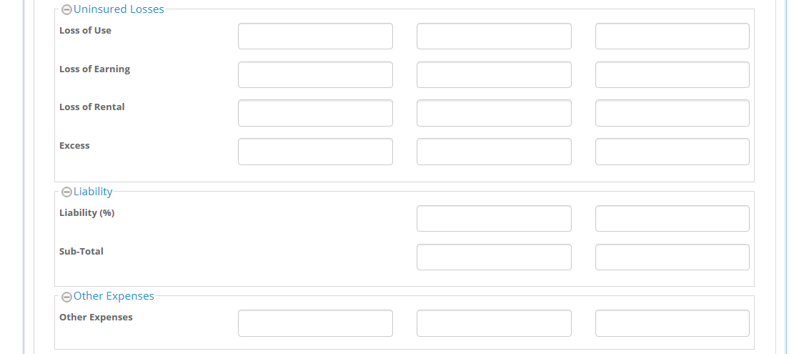
9.1.4) Uninsured Losses , Liability, Other Expenses sections

Slide 39
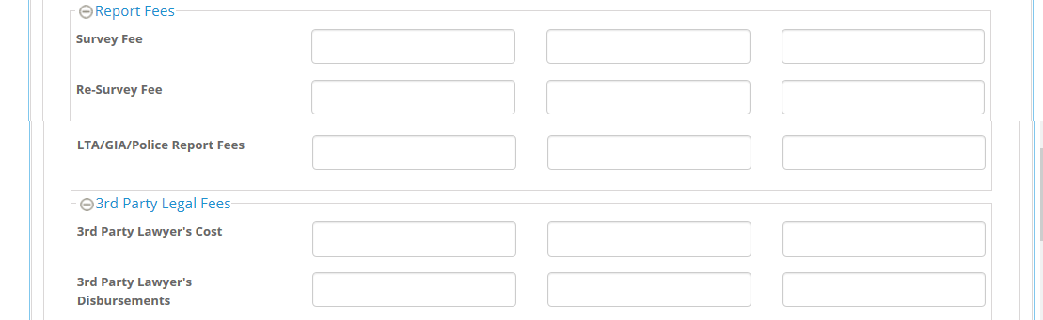
9.1.5) Report Fees , 3rd Party Legal Fees sections

Slide 40
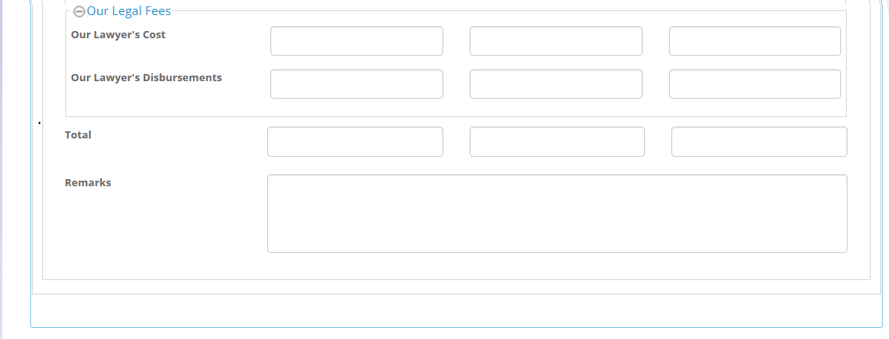
9.1.6) Our Legal Fees Section

Slide 41
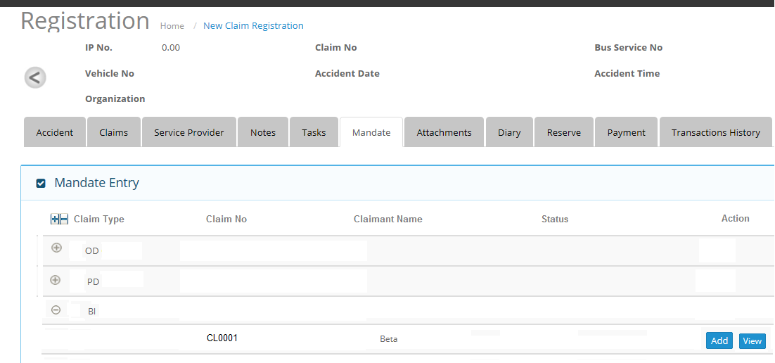
9.2) TPBI Mandate Approval
9.2.1) Header and Grid Section

Slide 42
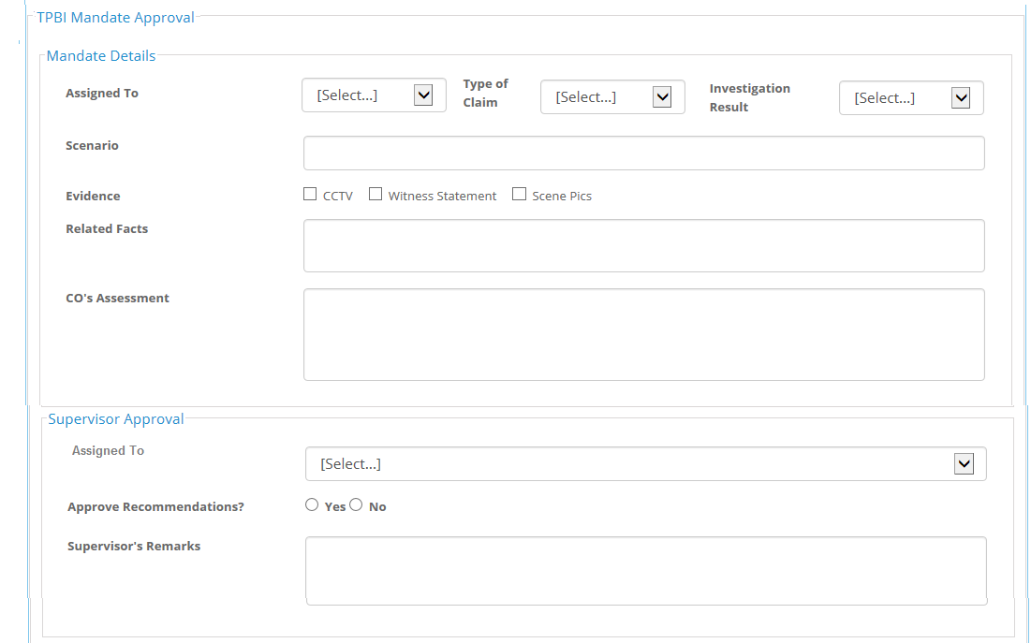
9.2.2) Mandate Details and Supervisor Approval Sections under TPBI Mandate Approval Frame

Slide 43
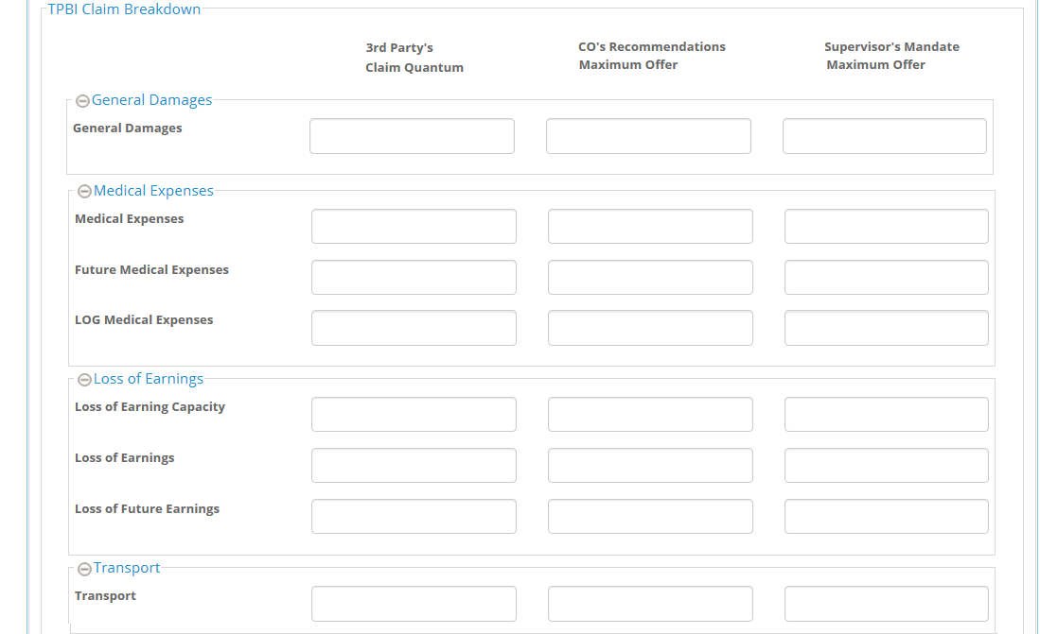
9.2.3) General Damages, Medical Expenses and Loss of Earnings Sections under TPBI Claim Breakdown Frame

Slide 44
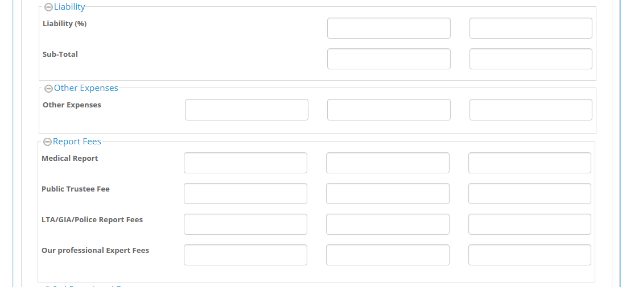
9.2.4) Liability, Other Expenses and Report Fees Sections

Slide 45
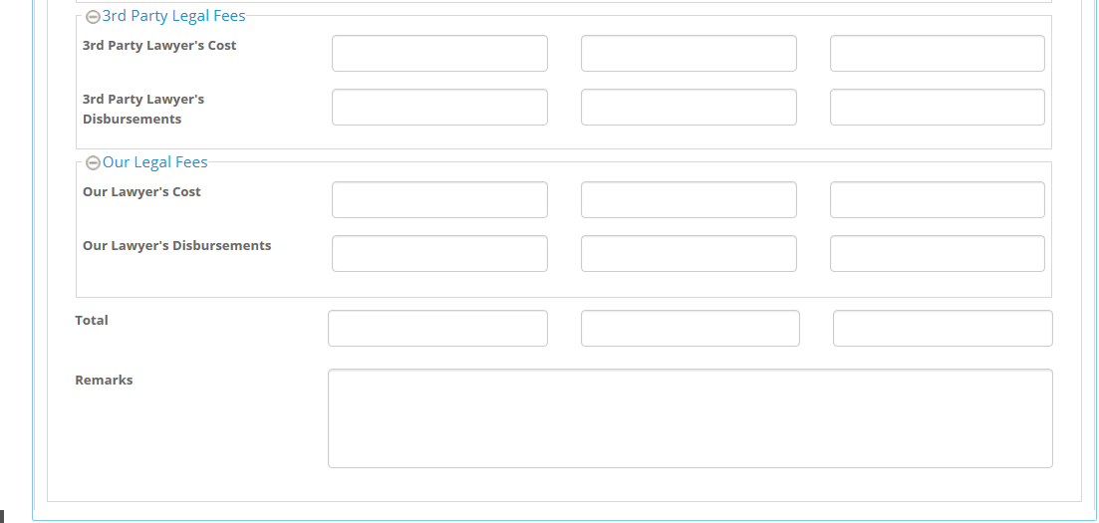
9.2.5) 3rd Prty Legal Fees and Our Legal fees Sections

Slide 46
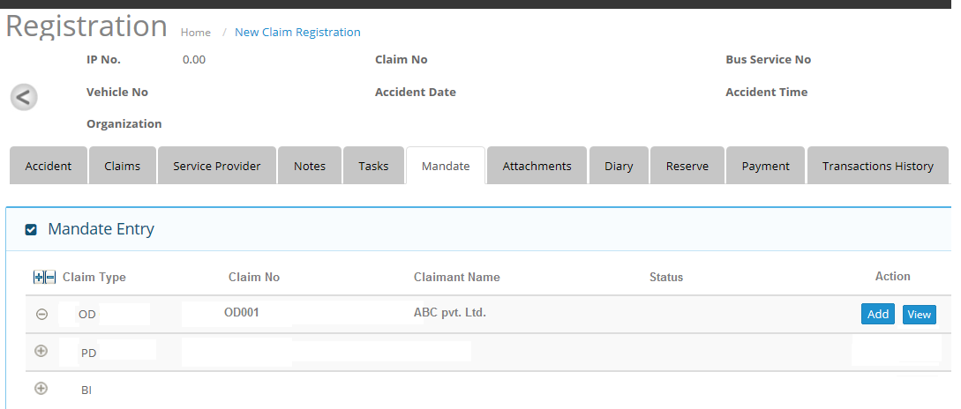
9.3) OD Mandate Approval
9.3.1) Header and Grid Details section

Slide 47
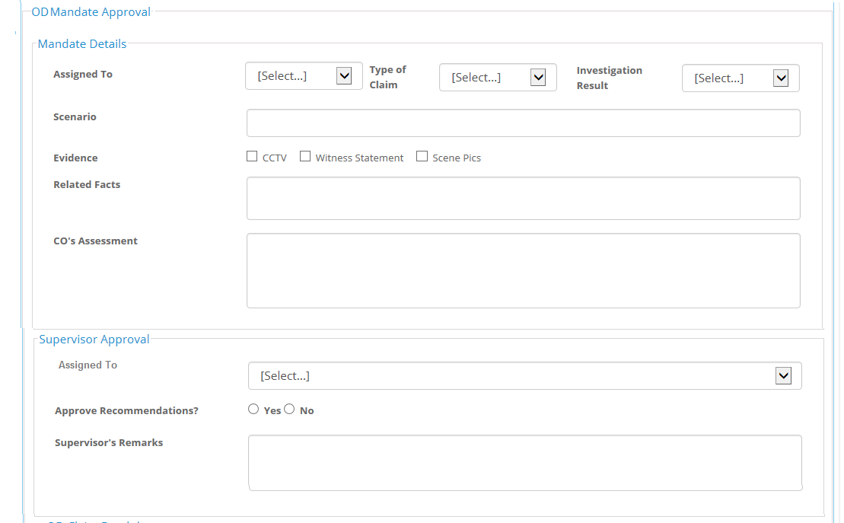
9.3.2) Mandate Details and Supervisor Approval sections under OD Mandate Approval frame

Slide 48
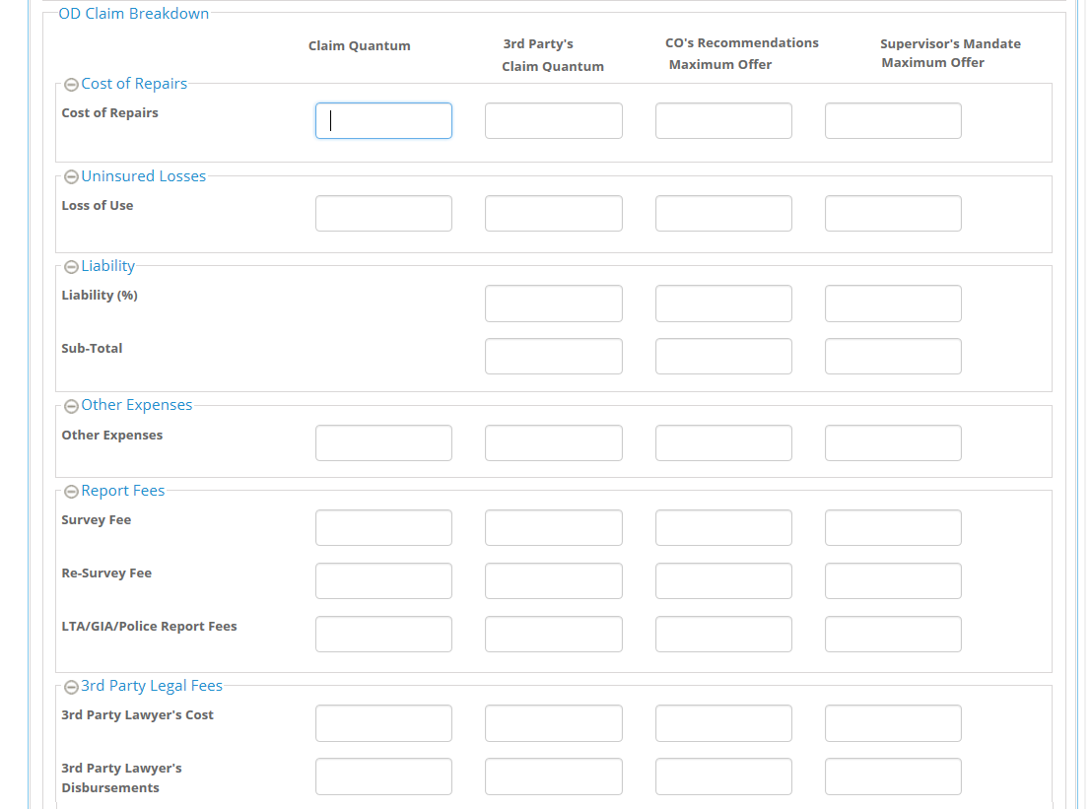
9.3.3) Cost of Repairs, Uninsured Losses , Liability , Other Expenses and Report fees sections

Slide 49

9.3.4) Our Legal Fees Section

Slide 50

Note: For CO Group user , Supervisor approval and supervisor mandate maximum order sections will be grayed out

Slide 51

10. Payment Mockup Screen
10.1 Claim Payment Grid

Slide 52

10.2 Payment Details Section

Slide 53


10.3 Supervisor Approval Section
10.4 Amount Due Section ( Cost of Repairs, Uninsured Losses,
Other Expenses )

Slide 54


10.5 Amount Due Section (Report Fees, 3rd Party Legal Fees, Our Legal Fees)

Slide 55

11. Transaction History Screen
11.1 Transaction history screen ( Part I )

Slide 56

11.2 Transaction history Detail screen ( Part II ) ( when click on any transaction in part 1 screen , this screen will come )

